Slide 1
ENGI 301 Project 2: PCB Project
November 22, 2020
Brian Dinh

Slide 2
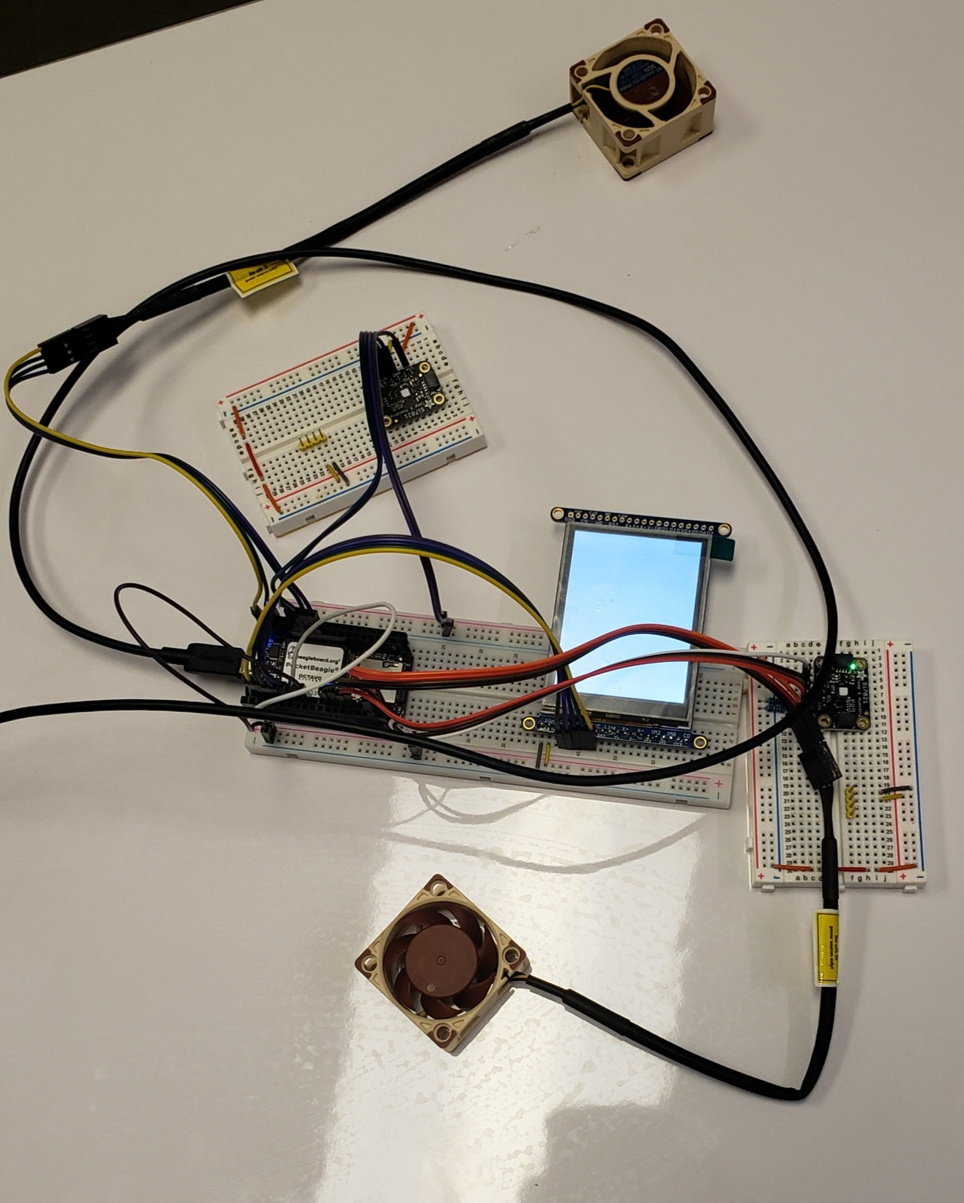
Background Information & Description of Board Functionality
What is being proposed?
PCBs for two components:
PocketBeagle design from Project 1- what was successfully completed (exclude the LED screen)
555 LED blinker
Links to existing projects / libraries
https://www.hackster.io/brian-dinh-rice2021/rice-university-engi-301-project-1-icyhot-7e1a75
https://www.hackster.io/eric-schneider/555-timer-led-blinkie-b26ecf
Description of board functionality:
Use results from Project 1 to transport it onto a PCB
Add LEB blinker because it looks cool

Slide 3
Detailed Description of Board Functionality
Project 1 IcyHot Components:
2 temperature sensors
2 PWM fans
What’s being expanded upon?
Add LED blinker
Design PCB involving all components
Why no LED screen?
Was not able to integrate it into the previous project
Project should be scoped to be 2 weeks
I struggled with the first project- second project must be fully integrated

Slide 4
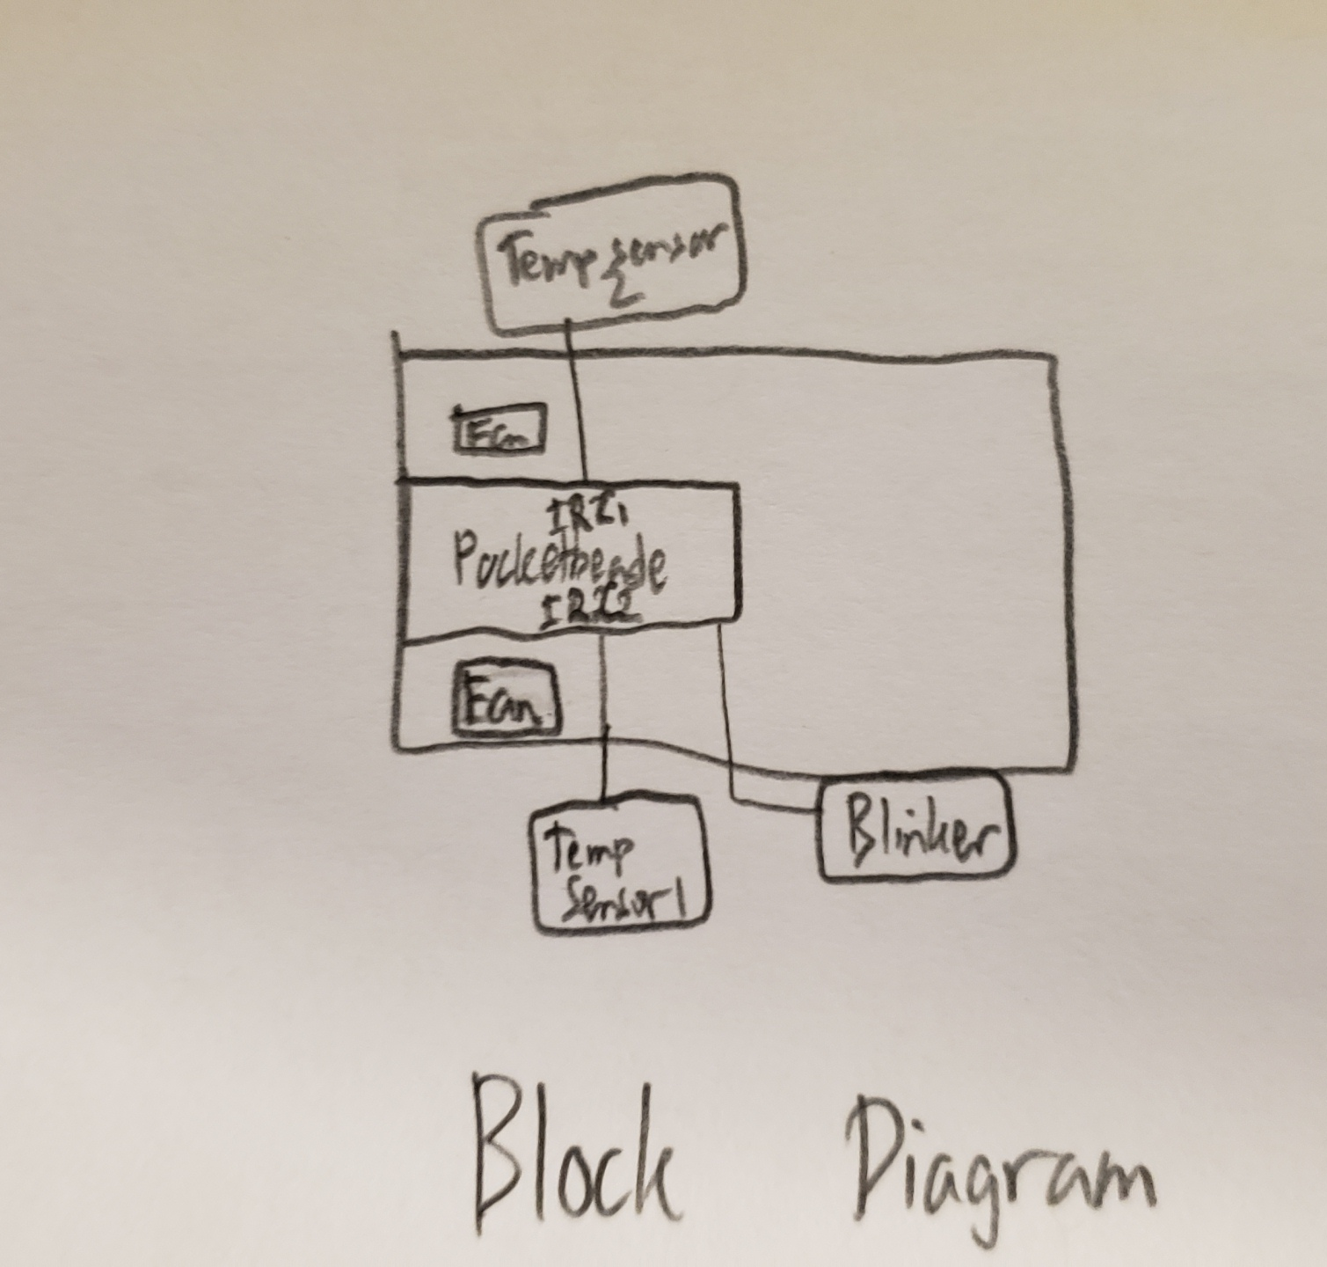
Functional Block Diagram

Slide 5
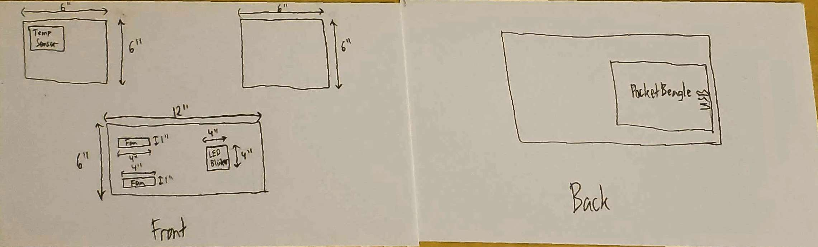
Mechanical Block Diagram: Dimensions of PCB

Slide 6
Components / Budget
Component | Need to Buy | Cost (USD)
None | --------- | ---------
Total |  | ---------

